Slide 1
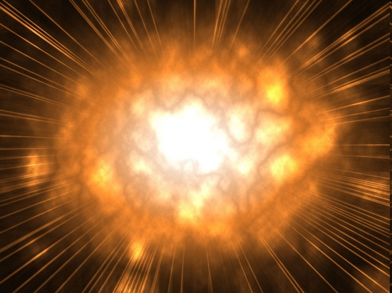

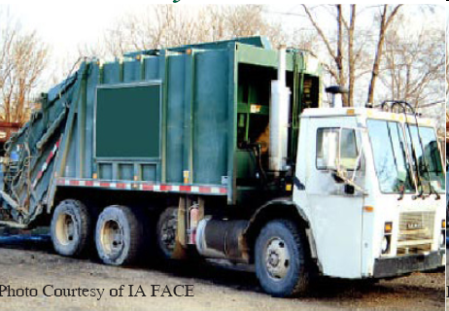
Our Reaction is Kind of Like This:
Imagine a bug…
flying very fast…
and there’s a garbage truck sitting there…
that our bug crashes into!!!

Slide 2

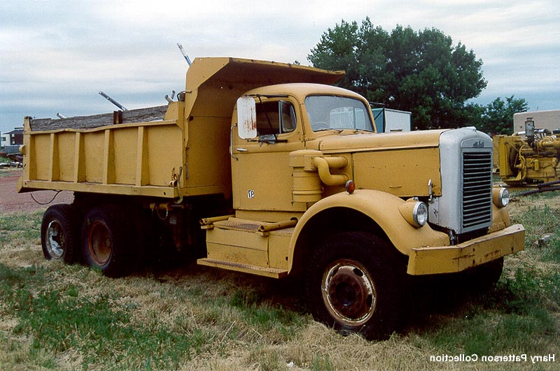
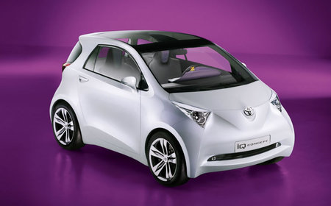
The Reaction Products
Mysteriously, the bug and
garbage truck are gone now…
a dump truck & small electric
car appear in their place…
And they drive off into the sunset!
Make
Sense!?

Slide 3
Unlikely process… but if it happened what physics rules apply?
Conservation of momentum (p_{before} = p_{after}).
Conservation of energy (KE_{BUG} = KE_{dump} + KE_{car}).
Conservation of mass & energy* (E = mc²).

Slide 4
Conservation of Momentum Restrictions
For each axis
p_{before} = p_{after}
p_{bug} + p_{garbage} = p_{dump} + p_{car}

Slide 5
Momentum Before the Collision
A 0.0001 kg bug is flying at a speed approaching light speed (3.0 x 10⁸ m/s) and crashes head on into a 16,000 kg garbage truck at rest.
In the axis of the bug’s motion.
The truck is not moving. This term = 0.
p_{before} = p_{bug} + p_{garbage}
p_{before} = (mv)_{bug} + (mv)_{garbage}
p_{before} = 0.0001kg(3 x 10⁸ m/s) + 0
p_{before} = 30,000 kg.m/s

Slide 6
Momentum After the Collision
Initial System
Momentum
(p_{y}) _{dump}
(p_{x}) _{dump}
p = 30,000 kg.m/s
x-axis only
(p_{x}) _{car}
(p_{y}) _{car}
(p_{x})_{car} + (p_{x})_{dump} = 30,000 kg.m/s
(p_{y})_{car} + (p_{y})_{dump} = 0 kg.m/s

Slide 7
Bug &Truck Summary
All the momentum comes from the bug flying in the x-axis.
The garbage truck starts with zero momentum.
After the collision, the car and dump truck momenta in the y-axis must be equal and opposite.
The sum of the car’s and dump truck’s momentum in the x-axis must equal the bug’s initial momentum.

Slide 8
What changes if…
the garbage truck idles and randomly rocks back and forth during the event?
The initial y-axis mometum varies moment to moment.
So typically, the initial p_{y} ≠ 0 kg.m/s, and
The sum of the final p_{y}’s also ≠ 0 kg.m/s.

Slide 9
The Particle Reaction is Like The Simulated Model Below…
neutrino + neutron → proton + muon
ν_{μ} + n⁰ → p⁺ + μ⁻
udd
uud
p⁺
υ_{μ−}
n⁰
μ⁻
Notice the neutron jiggling like the idling garbage truck did.

Slide 10

The neutrino reaction takes place in our 3-D world!
Let’s welcome the z-axis.
An extra dimension of space =
an extra dimension of FUN!
x-axis
(East)
p⁺
y-axis
(up)
υ_{μ−}
n⁰
μ⁻
z-axis
(North)
The neutrino comes along the z-axis.
The proton and muon fly off in the x, y ,and z axes.

Slide 11
p_{y}
p_{x}
p_{z}
Neutron at Rest
(p_{z})_{n} = (p_{z})_{p} + (p_{z})_{μ}
= (p_{z})_{ν}
(p_{x})_{n} = (p_{x})_{p} + (p_{x})_{μ}
= 0
(p_{y})_{n} = (p_{y})_{p} + (p_{y})_{μ}
= 0
Neutron in Motion
(p_{z})_{ν} + 0 = (p_{z})_{p} + (p_{z})_{μ}
= (p_{z})_{ν}
(p_{x})_{ν} + (p_{x})_{n} = (p_{x})_{p} + (p_{x})_{μ}
= 0
(p_{y})_{ν} + (p_{y})_{n} = (p_{y})_{p} + (p_{y})_{μ}
= 0

